Slide 1






MINI PROJECT PRESENTATION

Slide 2
PIZZ360 WEBSITE
Supervised By: -
Mr. Anand Parkash Gupta
Mrs. Ruchi Gupta
Asst. Professor
Department of Computer Engineering & Applications
GLA UNIVERSITY MATHURA
Submitted By:
Aryan Saxena
181500136
Divyansh Garg
181500222
Ishika Dubey
181500283

Slide 3
INTRODUCTION
Pizz360 (Web-based Application) is a perfect mate for our Pizza Lovers, that stimulates the foodies (customers) to get their Pizzas Delivered at home in just one click. This will be a user- friendly application with proper menu tabs defined on homepage. It will have both Veg and Non-Veg Pizza’s so that people can filter out based on their taste.
For this Application we will be using both Frontend and Backend Technologies and Database for storing the data.
Our major objective will be to make this Application as much user friendly as we can and satisfying the hunger of our customers in just few clicks.

Slide 4
OBJECTIVE
This website offers our customers a superior product i.e., that will promote customer loyalty, at a low price, and provide customer service that is second to none. Its objective is to satisfy the customer’s demand quality pizza that is delivered quickly with a smile.
Our goal is to deliver a website with a very clean user interface (website) where customers can select various kinds of pizza and place their order.

Slide 5
ABOUT WEB DEVELOPMENT
Web development is a broad term for the work involved in developing a web site for the Internet (World Wide Web). Web development commonly includes web engineering, web design, web content development, client-side/server-side scripting, web server and network security configuration, and e-commerce development. Among web professionals, “web development” usually refers to the main non-design aspects of building web sites: writing markup and coding. Websites are typically dedicated to a particular topic or purpose, ranging from entertainment and social networking to providing news and education.

Slide 6
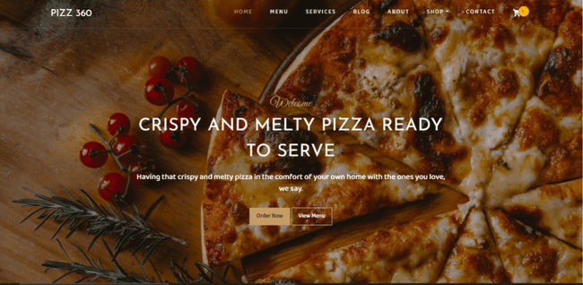
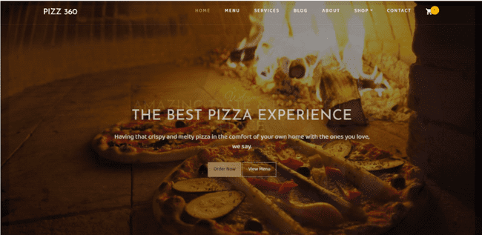
Desktop View

Slide 7
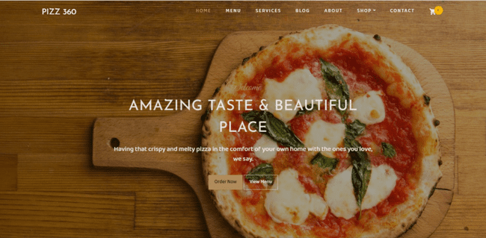
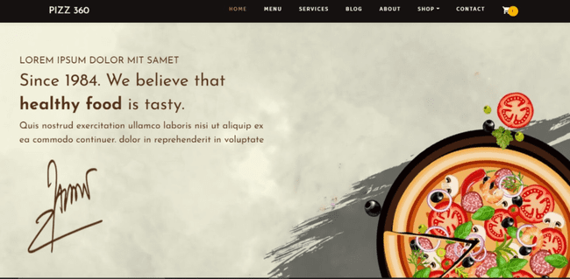

Slide 8
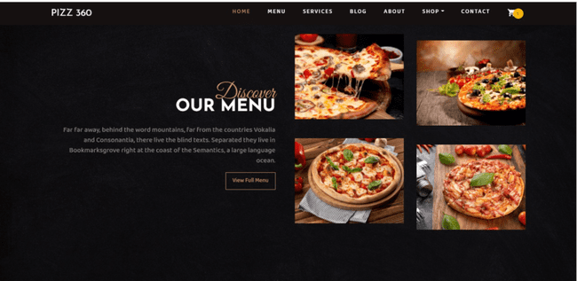

Slide 9
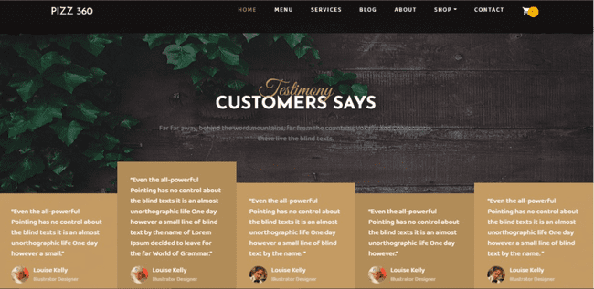
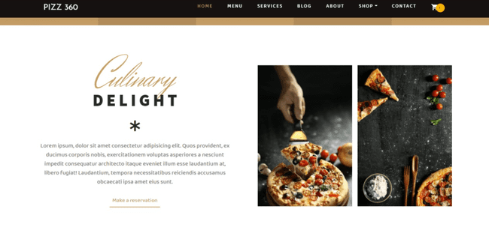

Slide 10

Technologies Used:
HTML5
HTML is the standard markup language for documents designed to be displayed in a web browser.
HTML describes the structure of a web page semantically and originally included cues for the appearance of the document.
HTML provides a means to create structured documents by denoting structural semantics for text such as headings, paragraphs, lists, links, quotes and other items.

Slide 11
Technologies Used:
CSS3
CSS is designed to enable the separation of presentation and content, including layout, colors, margins and also fonts.
This separation can improve content accessibility, provide more flexibility and control in the specification of presentation characteristics.
CSS enables multiple web pages to share formatting by specifying the relevant CSS in a separate .css file which reduces complexity and repetition in the structural content.

Slide 12
Technologies Used:
SCSS
The SCSS syntax uses the file extension .scss. With a few small exceptions, it’s a superset of CSS, which means essentially all valid CSS is valid SCSS as well.
It’s sometimes just called “Sass”. The indented syntax supports all the same features as SCSS, but it uses indentation instead of curly braces and semicolons to describe the format of the document.

Slide 13
Technologies Used:
JavaScript
JavaScript enables interactive web pages and is an essential part of web applications.
The vast majority of websites use it for client-side page behavior, and all major web browsers have a dedicated JavaScript engine to execute it.
As a multi-paradigm language, JavaScript supports event-driven, functional, and imperative programming styles.

Slide 14
Technologies Used:
Bootstrap
Bootstrap 4 is the newest version of Bootstrap.
Bootstrap is a free and open-source CSS framework directed at
responsive, mobile-first front-end web.
In addition, developers can take advantage of CSS classes defined in Bootstrap to further customize the appearance of their contents.
Bootstrap also comes with several JavaScript components in the form of jQuery plugins.

Slide 15
Technologies Used:
jQuery
jQuery is a fast, small, and feature-rich JavaScript library. It makes things like HTML document traversal and manipulation, event handling, animation, and Ajax much simpler with an easy-to-use API that works across a multitude of browsers.
The set of jQuery core features—DOM element selections, traversal and manipulation—enabled by its selector engine, created a new "programming style", fusing algorithms and DOM data structures

Slide 16
Technologies Used:
PHP
PHP is a server scripting language, and a powerful tool for making dynamic and interactive Web pages.
PHP is a widely-used, free, and efficient alternative to competitors such as Microsoft's ASP.
PHP 7 is the latest stable release.
The best things in using PHP are that it is extremely simple for a newcomer, but offers many advanced features for a professional programmer.

Slide 17
Technologies Used:
MySQL
MySQL is an open-source relational database management system (RDBMS).
MySQL has stand-alone clients that allow users to interact directly with a
MySQL database using SQL
MySQL is also used by many popular websites, including Facebook, Flickr,
MediaWiki, Twitter, and YouTube.

Slide 18
Tools Used:
Visual Studio Code - Visual Studio Code is a code editor redefined and optimized for building and debugging modern web and cloud applications. Its latest version is 1.50
XAMPP Server - XAMPP is an easy to install Apache distribution containing MariaDB, PHP, and Perl.
Google Chrome Web Browser - A fast, secure, and free web browser built for the modern web.

Slide 19

Live Demo Link
GitHub link:
https://divyanshgarg28.github.io/Pizz360/
GitHub Repository Link:
https://github.com/divyanshgarg28/Pizz360

Slide 20
CONCLUSION
With the help of latest web development technologies we have created a online pizza delivery web application ,named PIZZ360 , which has a descent graphical user interface the use of css and bootstrap also makes the pages beautiful and appealing ,this has been an excellent and rewarding learning experience. Needless to say, the technical aspects of the work we have done are not flawless and could be improved provided enough time.
As someone with no prior experience in web development, we believe our time spent in training and discovering new languages was well worth it and contributed to finding an acceptable solution to an important aspect of web design and development.

Slide 21
THANK YOU

